Slide 1

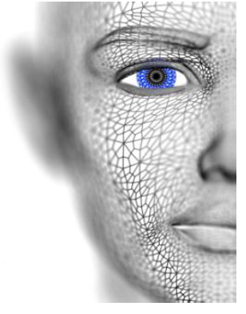
University of Missouri-Columbia - College of Engineering – Electrical Engineering and Computer Science Dept.
Localized Deep Learning Structure for The Large-Scale Biometric Data Recognition
PhD Candidate EECS
Adil Al-Azzawi
Adil Al-Azzawi

Slide 2
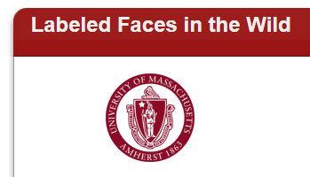






Dataset Collection
No. | Aim | # Persons | Total # images
1 | Labeled Faces In the Wild | 5,749 | 13,233
2 | CAISA-WebFace | 10,575 | 494,414
3 | MS-Celeb-1M Face | 100 K | 1 M
5 | VGG-Face | 2,622 | 2.6 M
6 | MegaFace | 672,057 | 4.7 M
Adil Al-Azzawi

Slide 3
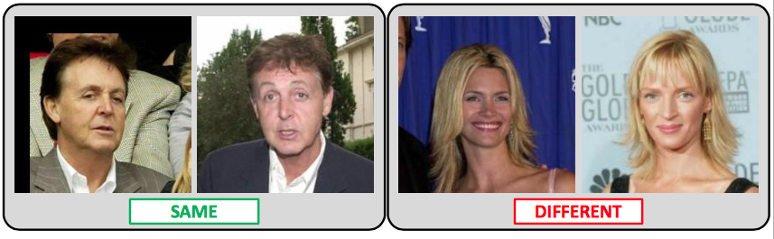
Task#1 (Deep Learning in Face)
Face Verification (1:1)
Given a pair of images specify whether they belong to the same person or different one.
Labeled Faces In the Wild Dataset (LFW)
13K images
5.7K people
Standard benchmark in the community
Several test protocols depending upon availability of training data within and outside the dataset.
SAME
DIFFERENT
[ G. Huang, M. Ramesh, T. Berg and E. Learned-Miller - Tech Report 07]
Adil Al-Azzawi
Notes:
LFW: Labeled Faces in the Wild Database
YTF: Youtube Faces

Slide 4
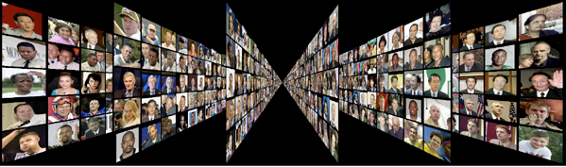

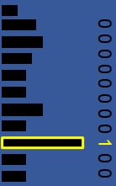
Task#2 (Deep Learning in Face)
Face identification (1:N)
Unconstrained Face Recognition Era: The Labeled Faces in the Wild (LFW)
13,233 photos of 5,749 celebrities
Probe
Gallery
FV
FC-8
DNN
FC-7
Identify
Labels
Adil Al-Azzawi

Slide 5
Labeled Faces In the Wild Dataset (LFW)
Effects of design choices LFW Unrestricted Protocol
No. | Network Config. | Dataset | Face Align Training | Face Align Testing | Embedding | 100%-EER
1 | A | Curated | No | No | No | 92.83
2 | A | Full | No | No | No | 95.80
3 | A | Full | No | Yes | No | 96.70
4 | B | Full | No | Yes | No | 97.72
5 | B | Full | Yes | Yes | No | 97.07
6 | D | Full | No | Yes | No | 96.60
7 | B | Full | No | Yes | Yes | 99.13
Comparison with the State of the Art (LFW Unrestricted Protocol)
No. | Method | # Training Images | # Networks | Accuracy
1 | Fisher Vector Faces | - | - | 93.10
2 | DeepFace | 4 M | 3 | 97.35
3 | DeepFace Fusion | 500 M | 5 | 98.37
4 | DeepID-2,3 | Full | 200 | 99.47
5 | FaceNet | 200 M | 1 | 98.87
6 | FaceNet+ Alignment | 200 M | 1 | 99.63
7 | VGG Face | 2.6 M | 1 | 98.95
Adil Al-Azzawi
Notes:
LFW: Labeled Faces in the Wild Database
YTF: Youtube Faces

Slide 6
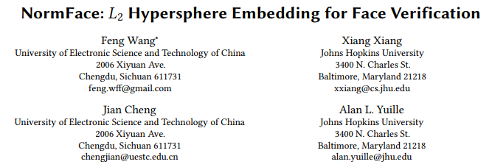
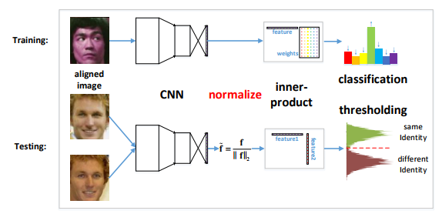
Labeled Faces In the Wild Dataset (LFW)
Baseline Model (caffe model)
No. | Baseline Model | Dataset | Face Align Training | Face Align Testing | Original Accuracy
1 | Lights CNN (MaxOut) | CAISA-Web Face | Yes | Yes | 98.41%
2 | Center Face (ResNet) | CAISA-Web Face | Yes | Yes | 99.03%
Redesign my Localized Deep Face for face verification
Try to use new lost function for fine tune the whole network
Adil Al-Azzawi
Notes:
LFW: Labeled Faces in the Wild Database
YTF: Youtube Faces

Slide 7
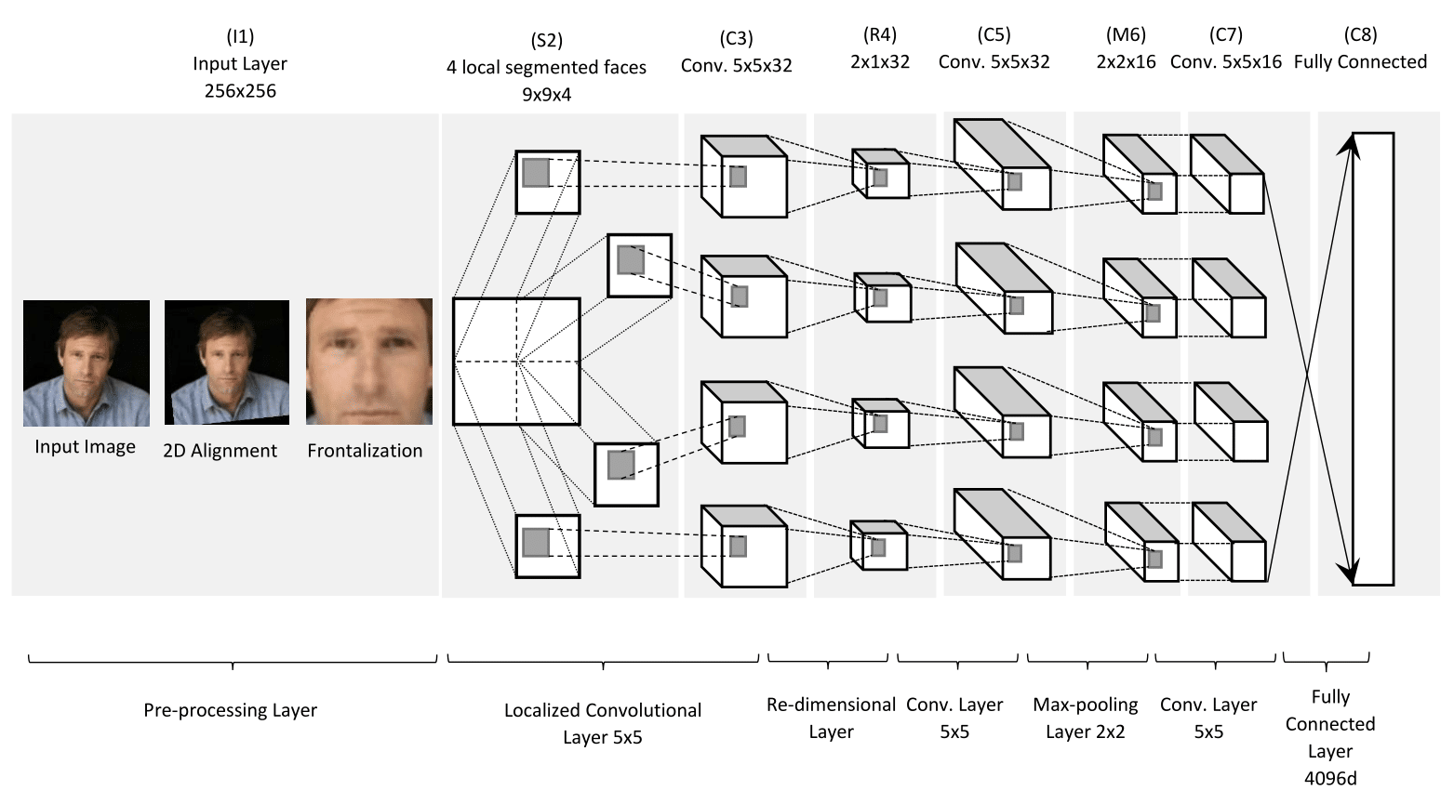
Localized Deep Face Model
Reconstruction our Model
No. | Activation Function | Iteration | Learning Rate | Dimension | Original Accuracy
1 | Softmax | 300,000 | 0.01 | 32x32 | 95.9%
2 | Softmax | 500,000 | 0.001 | 32x32 | 96.8%
3 | Softmax | 660,000 | 0.0001 | 32x32 | 96.78%
4 | Softmax | 500,000 | 0.001 | 64x64 | 97.18%
Adil Al-Azzawi
Notes:
LFW: Labeled Faces in the Wild Database
YTF: Youtube Faces

